Slide 1
THE RECORD OF OXYGEN CONSUMPTION

Slide 2
Fortunately, Fe and S have VERY different solubilities depending on their oxidation states. So the Fe and S cycles are VERY different in a reduced and oxidized world.

Slide 3
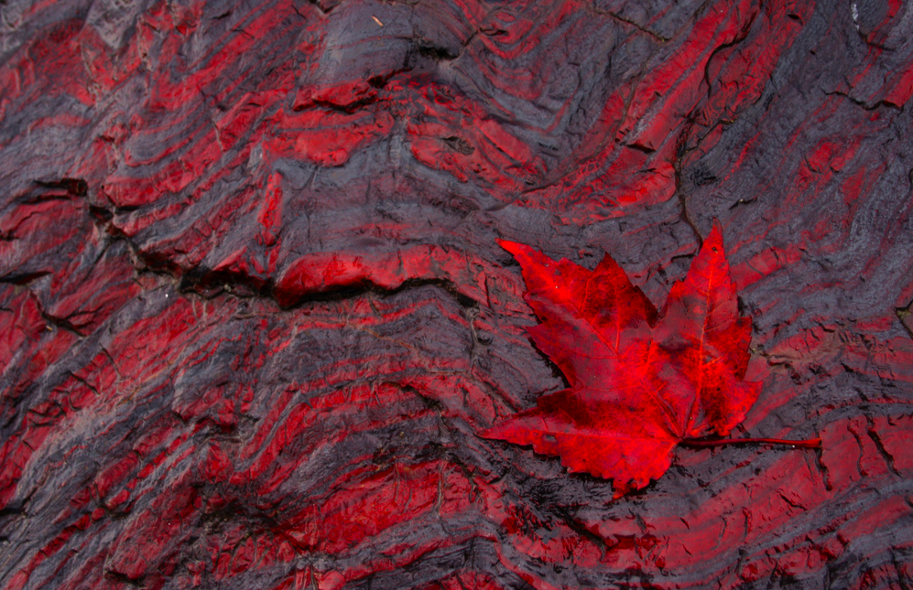

Slide 4
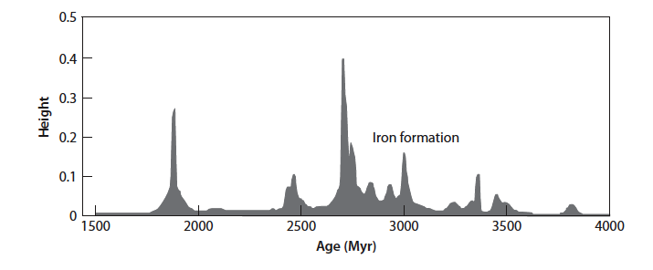

Slide 5
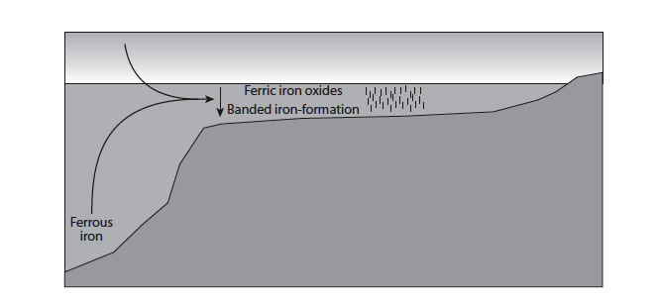

Slide 6
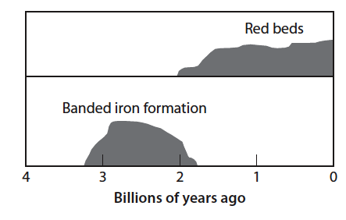

Slide 8
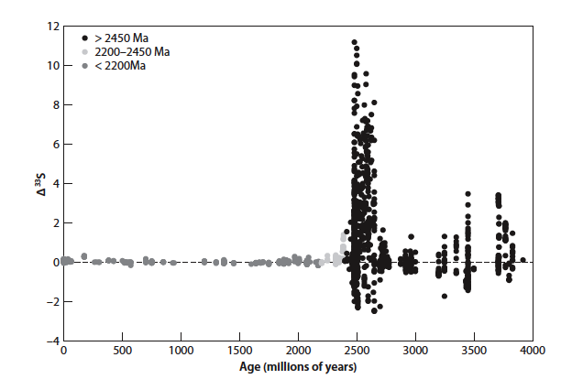

Slide 9
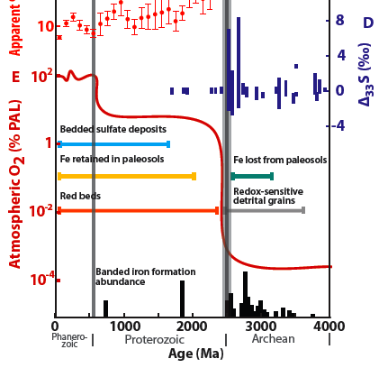

Slide 10
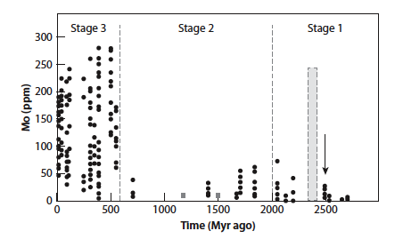

Slide 11
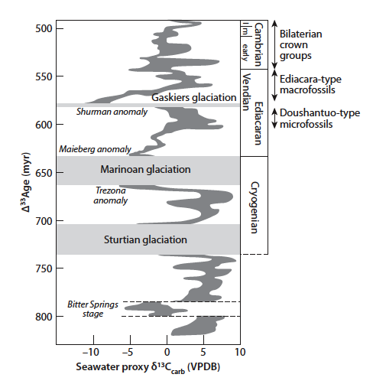

Slide 12
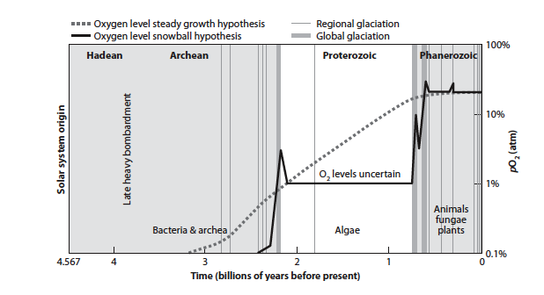

Slide 13
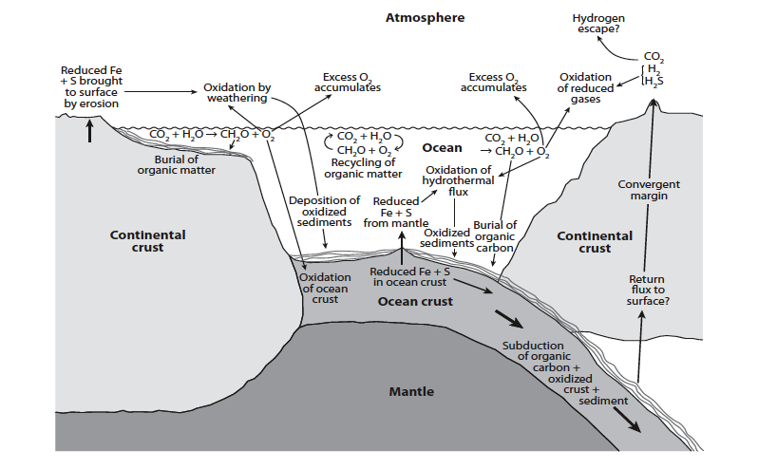

Slide 14
There must be mass balance between oxidized and reduced reservoirs Reservoirs of Carbon
Total organic carbon is 600 - 1250 *10¹⁸ moles

Slide 15
Oxidized Reservoirs

Slide 16
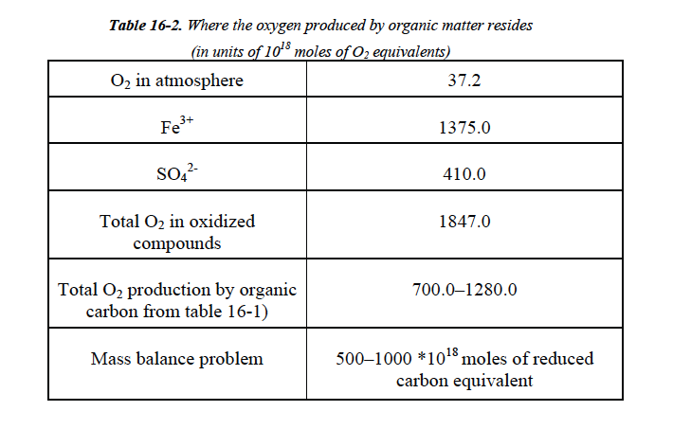

Slide 17
“Mass Balance Problem”
There should be an equivalence between the reduced and oxidized reservoirs
Observed reduced: 700 – 1300 examoles
Observed Oxidized: 1850 examoles
So there must be another reduced reservoir somewhere. Where could it be?

Slide 18
Mass balance problem = 500 - 1000 * 10¹⁸ moles of reduced carbon equivalent
Implies a large reduced reservoir somehere:
(a) Subducted organic carbon
(b) Hydrogen loss to space

Slide 19
One possible solution
“Methanogens” (methane generators) use this reaction to generate energy
Recall that H₂ can be lost from the upper atmosphere to space, which would result in a reduced reservoir of unknown (and untestable) size

Slide 20
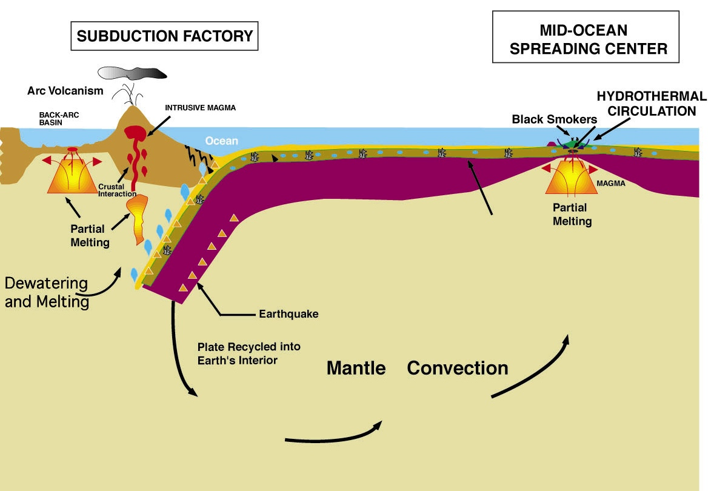
A second possible solution, subduction of organic carbon?

Slide 21
Ocean ridges are the largest source of reduced Fe and S to Earth’s surface

Slide 22
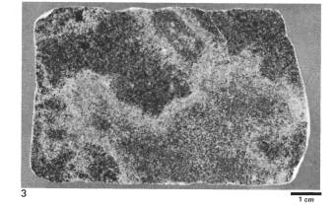
Oxidation of ocean crust is a critical term for O₂ mass balance
Ocean crust is oxidized as it interacts with seawater.
Photo from Alt et al.
ODP hole 504b.
Ferric iron increases by about 1 wt% by alteration of ocean crust at ridges
Flux is 8 * 10¹² moles per year.

Slide 23
Present Earth Is Out of Balance
Current burial rate of organic carbon (= O₂ production) is 0.68 * 10¹² moles/yr
Current flux of subducting Fe³⁺ is 2*10¹² equivalent moles
Suggests plate tectonic feedback on O₂

Slide 24
Ridge Feedback on Oxygen
Coupled sulfur and iron cycles lead to oxidation of the crust and release of sulfide and Fe²⁺ to the ocean
An oxidized deep ocean causes a large sink for oxygen
Conceptually, Earth’s surface may oxidize until the deep ocean is able to oxidize the crust. Then the new sink maintains the oxygen balance.

Slide 25
Has life oxidized the mantle?
To increase upper mantle Fe³⁺/Fe²⁺ by 1% requires 2 billion years of present Fe³⁺ subduction.
Data suggest deep ocean not oxidized prior to 700Ma
Even small increase of mantle Fe³⁺ requires thousands of examoles of subducted oxidized material-- makes mass balance problem MUCH worse
Production of oxidized species can have had only a negligible impact on mean upper mantle oxidation state

Slide 26
Ocean ridges are central to questions of O₂ over Earth’s history
They are the primary flux of reduced Fe and S to the surface
Recycling of oxidized Fe is a major term in the overall oxygen balance.

