Slide 1
ANTIMUSCARINIC DRUGS (M-CHOLINOLYTICS/ MUSCARINIC RECEPTORS ANTAGONISTS)

Slide 2
blockade of the actions of Ach /M-cholinomimetics on autonomic effectors and in CNS exerted through muscarinic (M) receptors.
They act as competitive pharmacologic antagonists and their blocking effects can be overcome by increased c% of muscarinic agonists.

Slide 3
Classification:
Natural alkaloids:
Atropine,
Scopolamine (Hyoscine);
2.Semiynthetic derivatives:
Homatropine,
Atropine methonitrate,
Ipratropium bromide,
Tiotropium bromide;

Slide 4
3.Synthetic compounds:
a.Mydriatics: Cyclopentolate, Tropicamide;
b.Antisecretory-antispasmodics:
* Quaternary compounds: Propantheline, Oxyphenonium, Glycopyrolate.
*Tertiary amines: Pirenzepine, Telenzepine, Oxybutynin.
c.Antiparkinsonian: Trihexyphenidyl, Procyclidine,
Benztropine.

Slide 5
Pharmacological actions
( Atropine as prototype)

Slide 6
1)EYE
-mydriasis (relaxation of sphincter of pupil);
-cycloplegia (relaxation of ciliary muscles);
-abolition of light reflex.
This resuls in photophobia and blurring of near vision.All last 7-10 days.
The intraocular tension tends to rise , specially in narrow angle glaucoma !!!.

Slide 7
2)UROGENITAL TRACT
-relaxant action on ureter and urinary bladder (urinary retention can occur);
- effect on uterus is minimal.
3)BRONCHI
-bronchodilation;
-reduced secretion.

Slide 8
4)GASTROINTESTINAL TRACT
-reduced tone and motility (relaxation, slowed peristalsis of stomach and intestine);
-decreased gastrointestinal secretion.
! however, peristalsis is only incompletely suppressed because it is primarily regulated by local reflexes and other neurotransmitters -5-HT; enkephalin- .
-relaxation of biliary tract is less marked.

Slide 9
5)HEART
-initial transient bradycardia caused by blockade of muscarinic autoreceptors on vagal nerve endings augmenting ACh release;
-then tachycardia from blockade of M₂ receptors in the heart.

Slide 10
6)VESSELS
-block of muscarinic vasodilation
7)EXOCRINE GLANDS
-marked reduction of salivation;
-moderate reduction of lacrimation, sweating
(M₃ blockade)

Slide 11
8) CNS
-Majority of the central actions are due to blockade of muscarinic receptors in the brain , but some actions may have a different bases.
-Atropine has an overall CNS stimulant action.These effects are not appreciable at low doses which produce peripheral effects because of restricted entry into the brain.
-Hyoscine produces depressant central effects even at low doses.
-atropine stimulates many medullary centers:vagal, respiratory, vasomotor.

Slide 12
-antimotion sickness action by depressing vestibular excitation;probably there it is a cholinergic link in the vestibular pathway or it is exerted at the cortical level.
-antiparkinson effect by blocking the relative cholinergic overactivity in basal ganglia.
-high doses →cortical excitation, disorientation, hallucinations , delirium, respirtory depression and coma

Slide 13
Clinical uses ( atropine and atropine substitutes)
ATROPINE:
It is an alkaloid found in Atropa belladonna (dedly nightshade) and in many other plants: Datura stramonium (Jamestown weed) or thorn aple.

Slide 14
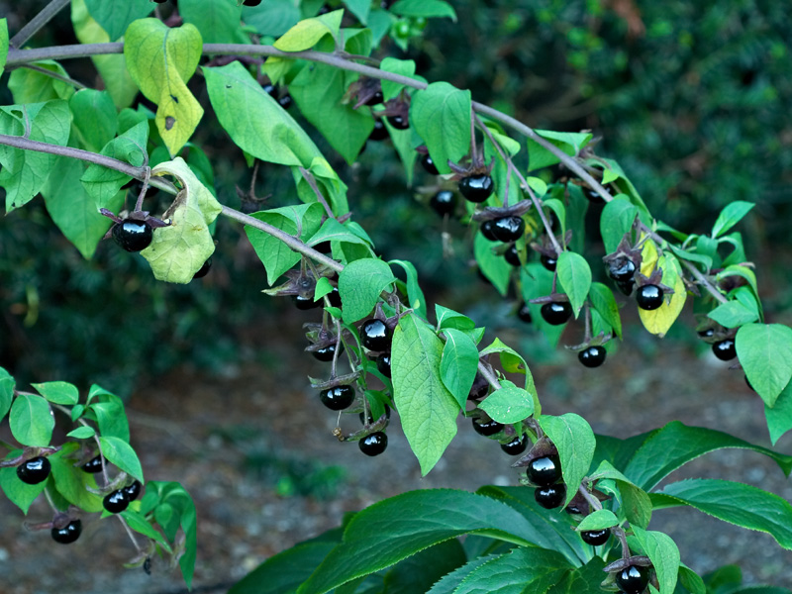

Slide 15
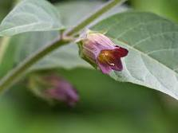

Slide 16
-It is a nonselective muscarinic blocker.
-It is rapidly absorbed from gastrointestinal tract.It is relatively lipid-soluble and readily crosses membranes barrier and applied to eyes freely penetrates cornea.It is well distributed into tissues including CNS. About 50% of atropine is metabolized in liver and rest is excreted unchanged in urine.

Slide 17
Clinical uses:
-in ophthalmology to dilate pupil and to paralyze accommodation (duration of action > 72 hours): for diagnostic purpose (for testing error of refraction or in fundoscopy) and in the treatment of iritis, iridocyclitis, choroiditis, keratitis, corneal ulcer
-Atropine is a potent mydriatic but its slow and long lasting action is undesirable for refraction testing. Though the pupil dilates in 30-40 min. , cycloplegia takes1-3 hours and the subject is visually handicapped for about 1 week ( !The substitutes attempt to overcome these difficulties)

Slide 18
-parenteral atropine is used to reduce airway secretions during general anesthesia(in surgery);
- atropine is useful in counteracting bradycardia and partial heart block in selected patients where increased vagal tone is responsible, e.g. is some cases of myocardial infarction, digitalis toxicity.
-in peptic ulcer disease to reduce secretion.
-treatment of overdosages with irreversible ChE inhibitors, intoxications with mushrooms.

Slide 19
SCOPOLAMINE:
-it is an alkaloid from Hyoscyamys niger;
-more potent on eye and secretory glands ;
-it is effective in motion sickness (due to blockade of cholinergic sites located in the vestibular nucleus and reticular formation); it should be given prophylactically (orally) because administration after symptoms have set in is less effective ;
!!! a transdermal preparation applied 4 hours before journey has been shown to protect for 3 days.
-it also has been used to produce sedation and amnesia during labour.

Slide 20
HOMATROPINE:
-It is used as mydriatic ; it is 10 times less potent than atropine.Instilled in eye it acts in 45-60 minutes, mydriasis lasts 1-3 days while accommodation recovers in 1-2 days.
ATROPINE METHONITRATE:
-It is an atropine substitute.Orally or i.m. is used for abdominal colics and hyperacidity.
-As an aerosol it is used in bronchial asthma and asthmatic bronchitis.

Slide 21
IPRATROPIUM BROMIDE:
-It acts selectively on bronchial muscle and causes bronchodilation and it is effective in chronic obstructive pulmonary disease and in bronchial asthma.It is used as aerosol.It is also used to control rhinorrhoea in perennial rhinitis and common cold.
TIOTROPIUM BROMIDE:-is a recently developed congener of ipratropium bromide which binds very tightly to bronchial M₁/ M₃ muscarinic receptors producing long lasting bronchodilation.

Slide 22
CYCLOPENTOLATE:
-it is used as a mydriatic agent; it is potent and rapidly acting: mydriasis and cycloplegia occur in 30-60 minutes and last about 1 day. It is used for refraction testing and in the treatment of iritis and uveitis.
TROPICAMIDE:
-It has the quickest (20-40 min) and briefest (3-6 hours) mydriatic action.It is used for refraction testing in adults and as a short acting mydriatic for fundoscopy.

Slide 23
TELENZEPINE:
-similar to pirenzepine, more potent.
OXYBUTYNIN:
-it is a recently introduced antimuscarinic agent;
-it has high affinity for receptors in urinary bladder and salivary glands with additional smooth muscle relaxant and local anesthetic properties;
-it is relatively selective for M₁/M₃ subtypes than for M₂;
-it is used for detrusor instability resulting in urinary frequency and urge incontinence;
-benefical effects have been demonstrated in neurogenic bladder, nocturnal enuresis

Slide 24
ANTINICOTINIC DRUGS
(N-CHOLINOLYTICS)

Slide 25
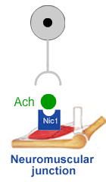
The mechanism of neuromuscular transmission at the end-plate is:
Arrival of an impuls at the motor nerve terminal:
-release of ACh;
-diffusion of ACh across the synaptic cleft to the N receptors located on the motor end plate→this causes opening of a Na⁺-K⁺ channel located within the receptor with depolarization of the endplate membrane.
Neuromuscular blocking drugs enter the open channel and block current flow.

Slide 26
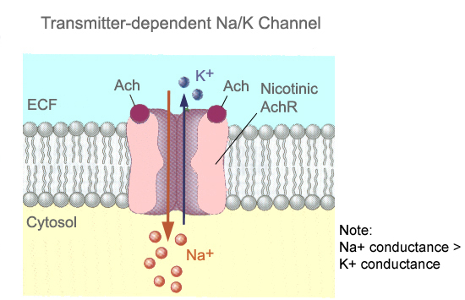

Slide 27
Classification:
These drugs are structural analogues of ACh and are classified in:
NONDEPOLARIZING AGENTS
DEPOLARIZING AGENTS

Slide 28
*NONDEPOLARIZING (COMPETITIVE) BLOCKERS

Slide 29
Mechanism of action:
-they act as competitive antagonists at the N receptors, i.e. the blockade of N receptors → this prevents Ach from attaching to the receptor sites and prevents depolarization→this results in nondepolarization of the motor end plate and complete paralyses without fasciculations occurring;

Slide 30
-the action of nondepolarising agents can be reversed by increasing the amount of Ach at the neuromuscular junction.
-This can be achieved with administration of an acetylcholinesterase inhibitor (Neostigmine, combined with atropine or glycopyrrolate -to reduce unwanted muscarinic stimulation- is commonly used for this purpose ).
-some drugs in this group may also act directly to plug the ion channel operated by the ACh receptors.

Slide 31
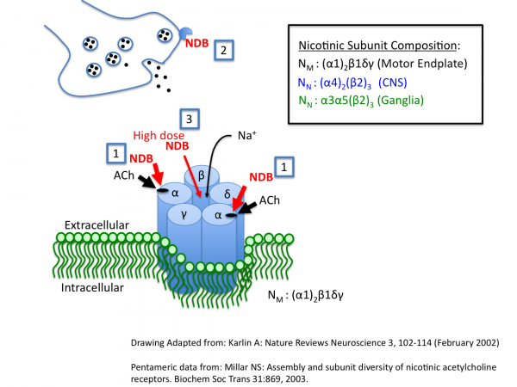

Slide 32
There are 3 mechanisms by which nondepolarizing neuromuscular blockers can contribute to skeletal muscle relaxation.
At low concentrations they compete with acetylcholine (ACh) for binding to postsynaptic nicotinic receptor sites in the skeletal muscle neuro-muscular junction.
Nondepolarizing relaxants also interfere with presynaptic release of ACh from motor nerve endings by still poorly understood mechanism(s). Both block of Na channels and block of pre-synaptic nicotinic autoreceptors have been implicated.
At higher concentrations they can also produce a more intense motor blockade by blocking the pore of the nicotinic receptor-channel complex.

Slide 33
Clinical uses

Slide 34
Muscle relaxant during surgery
the prevention of dislocations and fractures which may be induced by electroshock;
-Facilitate endotracheal intubation by relaxing laryngeal & jaw muscles - which is necessary before inhalational general anesthetics can be administered.
Treatment of spasticity caused by injury to or disease of CNS.
Treat seizures electrically induced or induced by drugs.
Diagnosis of myasthenia gravis.
the control of muscles spasm in tetanus.

Slide 35
The ideal skeletal muscle relaxant should have:
a rapid onset of action (to allow rapid intubation)
a duration of action similar to the duration of the interventional procedure (endoscopy, surgery)
no side effects

Slide 36
-the first drug was CURARA used by Indians from South America in hunting animals (they were using arrows tipped in curare to paralyze animals);today alkaloids from curare are used.

Slide 37
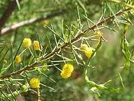
Acacia tetragonophylla, commonly known as curara, kurara or dead finish, is a tree in the family Fabaceae ( Australia).

Slide 38
D-TUBOCURARINE:-it is the most important curare alkaloid ;
-it is composed by two quaternary ammonium groups separated by a complex aromatic structure;
-it is given i.v.; it is not absorbed from the gastrointestinal tract and it fails to enter the CNS.
-relatively slow onset of action (4-6 mins)
-long duration of action (80-120 mins)

Slide 39
Pharmacological effects:
-administerd i.v. it causes first a loss of muscular tone (due to blockade of the receptors);
-next a flaccid paralysis ensues (first the muscles of eyelids, then the muscles of the mimicks, neck, legs, abdomen, respiratory muscles.When respiratory muscles are paralyzed apnoea occurs.Therefore, to ensure the artificial ventilation when D tubocurarine and related agents are administered is an absolute requirement.

Slide 40
Side effects:
-significant side effects - histamine release from mast cells - causing bronchospasm, hypotension, salivary secretions.
-ganglionic blockade;
! d-tubocurarine is the prototype non-depolarizing skeletal muscle relaxant. It is now rarely used.

Slide 41
Other nondepolarizing agents:
Nomenclature Heads Up:
Steroid derivatives (pancuronium, pipercuronium, rocuronium, etc) end in ”curonium”
Isoquinolone derivatives (atracurium, doxacurium, mivacurium, etc) end in ”curium”

Slide 42
METOCURINE: synthetic derivative of D-tubocurarine ;-more potent and with longer duration of action.
GALLAMINE: -it also blocks M₂ receptors of the heart with tachycardia, arrhythmias.
PANCURONIUM(bromide): -it is a synthetic steroid bis-quaternary neuromuscular blocker; -it is five times more potent than D – tubocurarine; it fails to release histamine and to block ganglia.

Slide 43
VECURONIUM(bromide): it is a monoquaternary analogue of pancuronium; it doesn’t block ganglia.
ATRACURIUM: it has a short duration of action and it is used in short surgical procedures; it spontaneously degrades in plasma and it is the only nondepolarizing blocking drug whose dose need not be reduced in patients with renal failure.
PIPECURONIUM(bromide): similar to pancuronium but more potent.

Slide 44
ALCURONIUM:very akin to D- tubocurarine but with less side effects.
Rocuronium: rapid onset (1-2 mins) & intermediate duration (30-60 mins). An alternative for succinylcholine in emergency cases where rapid-induction of anesthesia is needed.
Mivacurium: intermediate onset of action (2-4 mins) & short duration of action (12-18 mins). No antimuscarinic or ganglionic blocking effects. Slight histamine release.

Slide 45
*DEPOLARIZING AGENTS

Slide 46
-they act as nicotinic agonists ( like Ach); unlike Ach they are not destroyed by acetylcholinesterase ( AChE) , therefore they produce a sustained activation of the nicotinic receptors; the action of depolarizing agents can be terminated by administration of a pseudocholinesterase;
-they cause prolonged depolarization which renders the membranes refractory to the next stimulus ;

Slide 47
-these drugs have not clinical applications, the block produced by these drugs cannot be controlled adequately.
-the initial depolarization is accompanied by twitching and continuous depolarization results in muscle relaxation and paralysis.

Slide 48
The sole drug used from this group is SUCCINYLCHOLINE (SUXAMETHONIUM) which is the ester of succinic acid with two moieties of choline.It has a short duration of action (few minutes) if given as a single dose.This compound is rapidly metabolized by pseudocholinesterase, elaborated by the liver.The resulting compounds are: succinylmonocholine (much less active), choline and succinic acid.

Slide 49
In most instances it causes fibrillations and fasciculattions prior to muscular relaxation.
It acts in two phases:
*In lower doses it causes the opening of the Na⁺ channel associated with the nicotinic receptors which results in depolarization and this leads to a transient twitching of the muscle.
*The continuous binding of the depolarizing agent renders the receptors incapable of transmitting further impulses.In time, membrane repolarizes but the nicotinic receptor is desensitized to effects of ACh / cholinomimetic drugs.This causes within a few minutes after fascicullations a flaccid paralysis.

Slide 50
Clinical uses:
-it is useful when rapid endotracheal intubation is required during the induction of anesthesia;
-more rare it is used as an adjuvant in the treatment of fractures and dislocations.

Slide 51
Side effects:
-apnoea: due to the paralyses of the diaphragm if there it is a genetically related deficiency of pseudocholinesterase;
-postoperatively, muscle pain may occur due to the fasciculattions which induce the release of myoglobin;
-due to the contractions of extraocular muscles the danger of transient elevated intraocular pressure may occur.
-hyperpotassemia as a result of muscular stimulation ; it may cause cardiac arrhythmias.

